Slide 1
Introduction of Deep Learning
Notes:
Actually for every machine learning
Three things: model, cost, learning

Slide 2
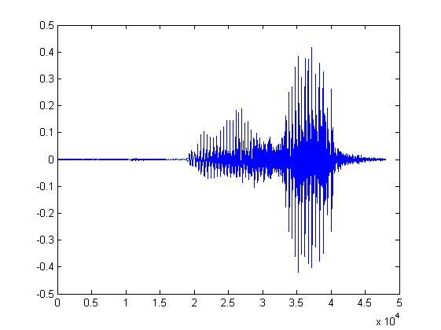

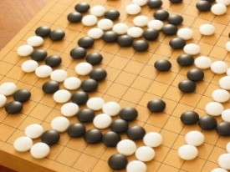
Machine Learning ≈ Looking for a Function
Speech Recognition
Image Recognition
Playing Go
Dialogue System
“How are you”
“Cat”
“5-5”
(next move)
“Hi”
“Hello”
(what the user said)
(system response)

Slide 3
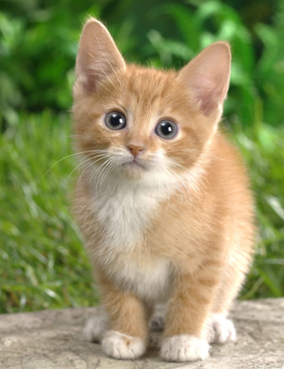

Framework
Image Recognition:
“cat”
A set of function
Model
“cat”
“monkey”
“dog”
“snake”
Notes:
Repeat again

Slide 4
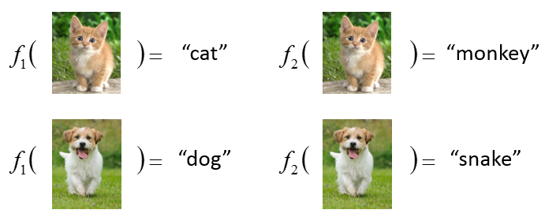
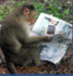
Framework
Image Recognition:
“cat”
A set of function
Model
Better!
Goodness of function f
Supervised Learning
Training
Data
function input:
function output:
“monkey”
“cat”
“dog”
Notes:
Repeat again

Slide 5
Framework
Image Recognition:
“cat”
A set of function
Model
Training
Testing
“cat”
Step 1
Goodness of function f
Pick the “Best” Function
Using
Step 2
Step 3
Training
Data
“monkey”
“cat”
“dog”
Notes:
Repeat again

Slide 6
Three Steps for Deep Learning
Step 1: define a set of function
Step 2: goodness of function
Step 3: pick the best function
Neural Network

Slide 7
Neural Network
Neuron
A simple function
…
…
…
…
Activation function
weights
bias
Notes:
sigmoid

Slide 8
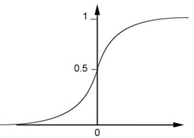
Neural Network
Neuron
Sigmoid Function
2
1
4
-1
-2
0.98
Activation function
-1
1
weights
1
bias
Notes:
sigmoid

Slide 9
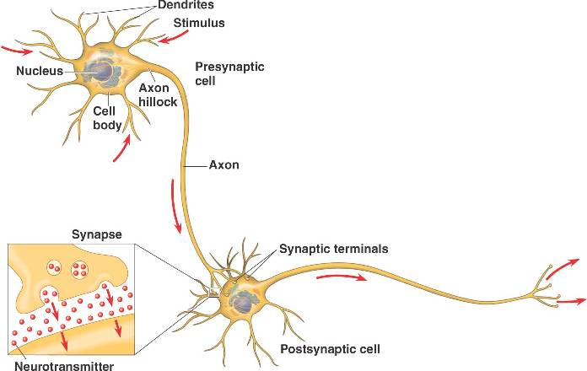
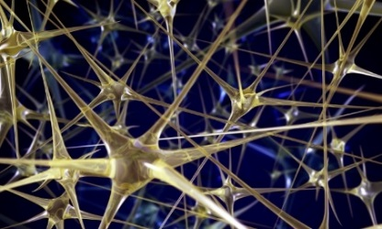
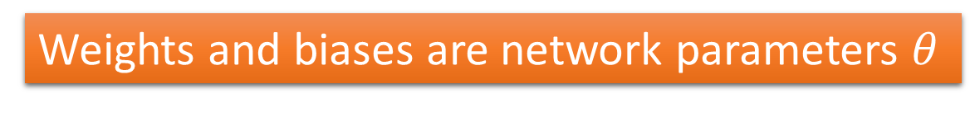
Neural Network
Different connections lead to different network structures
The neurons have different values of weights and biases.
Weights and biases are network parameters $θ$
Notes:
The values of weights and biases will be obtained by learning (step 3).

Slide 10
Fully Connect Feedforward Network
1
4
0.98
1
-2
1
-1
-2
0.12
-1
1
0
Sigmoid Function

Slide 11
Fully Connect Feedforward Network
1
4
0.98
2
0.86
3
0.62
1
-2
-1
-1
1
0
-2
-1
-2
0.12
-2
0.11
-1
0.83
-1
1
-1
4
0
0
2

Slide 12
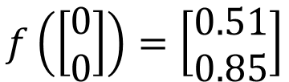
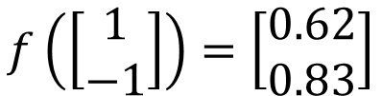

Fully Connect Feedforward Network
1
0.73
2
0.72
3
0.51
0
-2
-1
-1
1
0
-2
-1
0.5
-2
0.12
-1
0.85
0
1
-1
4
0
0
2
This is a function.
$$f\left(\left[\begin{matrix}1 \\ −1\end{matrix}\right]\right)=\left[\begin{matrix}0.62 \\ 0.83\end{matrix}\right]$$
$$f\left(\left[\begin{matrix}0 \\ 0\end{matrix}\right]\right)=\left[\begin{matrix}0.51 \\ 0.85\end{matrix}\right]$$
Input vector, output vector
Given parameters $θ$, define a function
Given network structure, define a function set
Notes:
For example, if we modify “1” to “2”, then we have another function

Slide 13
Fully Connect Feedforward Network
neuron
Input
Layer 1
Layer 2
Layer L
Output
……
y₁
……
y₂
……
……
……
……
……
……
y_{M}
Input Layer
Output Layer
Hidden Layers
Deep means many hidden layers

Slide 14
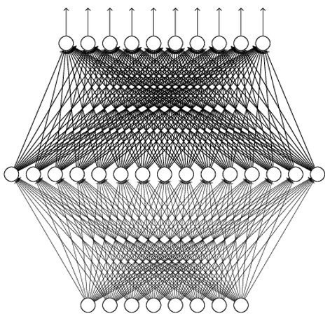
Why Deep? Universality Theorem
Any continuous function f
Can be realized by a network with one hidden layer
(given enough hidden neurons)
Reference for the reason: http://neuralnetworksanddeeplearning.com/chap4.html
Why “Deep” neural network not “Fat” neural network?

Slide 15
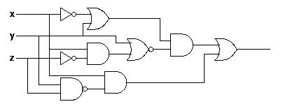
Why Deep? Analogy
Logic circuits
Neural network
Logic circuits consists of gates
A two layers of logic gates can represent any Boolean function.
Using multiple layers of logic gates to build some functions are much simpler
Neural network consists of neurons
A hidden layer network can represent any continuous function.
Using multiple layers of neurons to represent some functions are much simpler
less parameters
less data?
less gates needed
More reason: https://www.youtube.com/watch?v=XsC9byQkUH8&list=PLJV_el3uVTsPy9oCRY30oBPNLCo89yu49&index=13

Slide 16
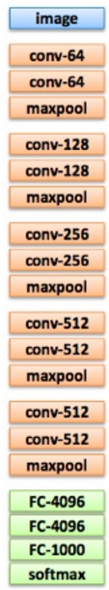
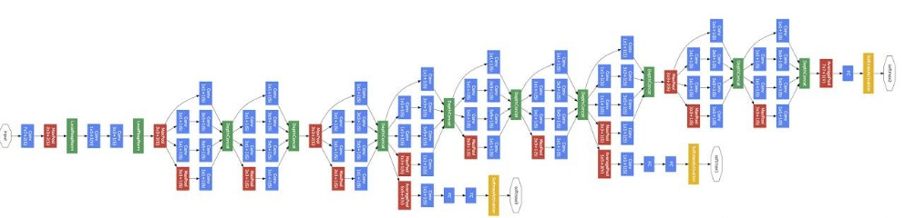
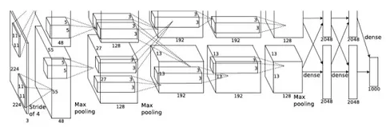
Deep = Many hidden layers
22 layers
http://cs231n.stanford.edu/slides/winter1516_lecture8.pdf
19 layers
8 layers
6.7%
7.3%
16.4%
AlexNet (2012)
VGG (2014)
GoogleNet (2014)

Slide 17
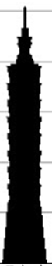
Deep = Many hidden layers
101 layers
152 layers
Special
structure
3.57%
7.3%
6.7%
16.4%
AlexNet (2012)
VGG
(2014)
GoogleNet
(2014)
Residual Net
(2015)
Taipei
101
Notes:
，曾於2004年12月31日至2010年1月4日間擁有世界第一高樓的紀錄

Slide 18
Output Layer
Softmax layer as the output layer
Ordinary Layer
In general, the output of network can be any value.
May not be easy to interpret
Notes:
Original output layer is local

Slide 19
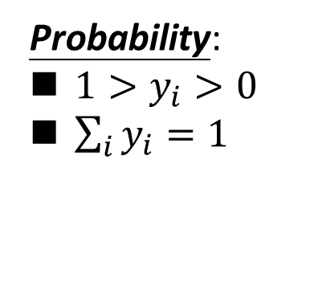
Output Layer
Probability:
$1>y_{i}>0$
$\sum_{i}{y_{i}=1}$
Softmax layer as the output layer
Softmax Layer
3
20
0.88
1
2.7
0.12
-3
0.05
≈0
Notes:
Why it is name soft max?
Monotonicity of softmax
Non-locality of softmax

Slide 20
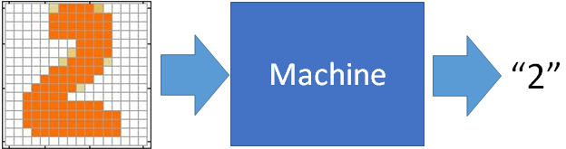
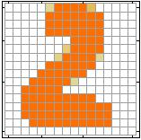
Example Application
Input
Output
y₁
is 1
0.1
y₂
is 2
0.7
The image is “2”
……
……
……
y₁₀
0.2
is 0
16 x 16 = 256
Ink → 1
No ink → 0
Each dimension represents the confidence of a digit.
Notes:
The same for even more complex tasks.

Slide 21
Example Application
Handwriting Digit Recognition
y₁
is 1
Machine
y₂
is 2
Neural
Network
“2”
……
……
……
y₁₀
is 0
What is needed is a function ……
Input:
256-dim vector
output:
10-dim vector
Notes:
The same approach for other cases

Slide 22
Example Application
Input
Layer 1
Layer 2
Layer L
Output
……
y₁
is 1
……
A function set containing the candidates for
Handwriting Digit Recognition
y₂
is 2
“2”
……
……
……
……
……
……
……
y₁₀
is 0
Input Layer
Output Layer
Hidden Layers
You need to decide the network structure to let a good function in your function set.

Slide 23
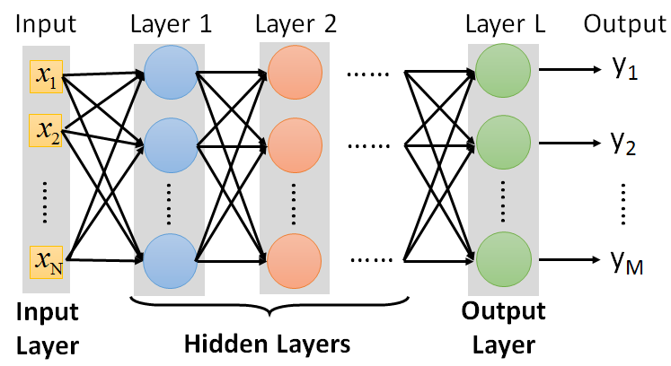
FAQ
Q: How many layers? How many neurons for each layer?
Q: Can we design the network structure?
Q: Can the structure be automatically determined?
Yes, but not widely studied yet.
Trial and Error
+
Intuition
Of course. You have many choices.

Slide 24
Highway Network
Residual Network
Highway Network
+
copy
Gate controller
copy
Deep Residual Learning for Image Recognition
http://arxiv.org/abs/1512.03385
Training Very Deep Networks
https://arxiv.org/pdf/1507.06228v2.pdf

Slide 25
output layer
output layer
output layer
Highway Network automatically
determines the layers needed!
Input layer
Input layer
Input layer

Slide 26
Three Steps for Deep Learning
Step 1: define a set of function
Step 2: goodness of function
Step 3: pick the best function

Slide 27
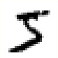

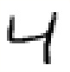




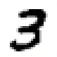
Training Data
Preparing training data: images and their labels
“5”
“0”
“4”
“1”
“9”
“2”
“1”
“3”
The learning target is defined on the training data.
Notes:
(學習教材)

Slide 28

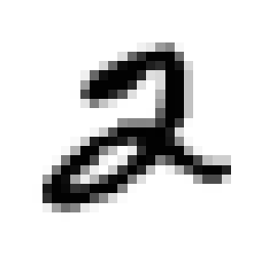
Learning Target
……
y₁
is 1
……
y₂
Softmax
is 2
……
……
……
……
y₁₀
is 0
16 x 16 = 256
Ink → 1
No ink → 0
The learning target is ……
Input:
y₁ has the maximum value
Input:
y₂ has the maximum value

Slide 29
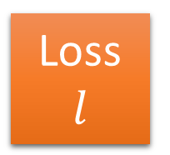
Loss
A good function should make the loss of all examples as small as possible.
“1”
……
y₁
1
As close as possible
……
y₂
Given a set of parameters
0
Softmax
……
……
……
……
……
Loss
$$l$$
……
y₁₀
0
Loss can be square error or cross entropy between the network output and target
target
Notes:
With softmax, the summation of all the ouputs would be one.
Can be considered as probability if you want ……

Slide 30
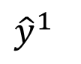
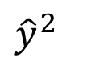
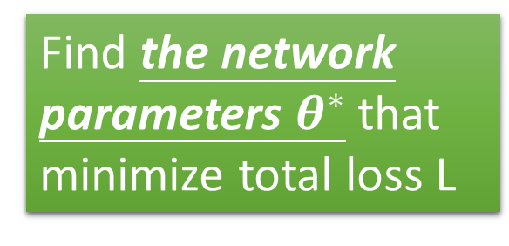
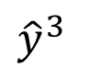
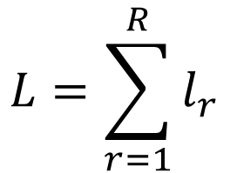
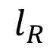
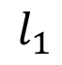
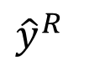
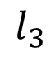
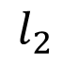
Total Loss
Total Loss:
$$L=\sum_{r=1}^{R}{l_{r}}$$
For all training data …
x¹
NN
y¹
$${\hat{y}}^{1}$$
$$l_{1}$$
As small as possible
x²
NN
y²
$${\hat{y}}^{2}$$
Find a function in function set that minimizes total loss L
$$l_{2}$$
x³
NN
y³
$${\hat{y}}^{3}$$
$$l_{3}$$
……
……
……
……
Find the network parameters $θ^{∗}$ that minimize total loss L
x^{R}
NN
y^{R}
$${\hat{y}}^{R}$$
$$l_{R}$$
Notes:
Randomly picked one
Two approaches update the parameters towards the same direction, but stochastic is faster!
Better!

Slide 31
Three Steps for Deep Learning
Step 1: define a set of function
Step 2: goodness of function
Step 3: pick the best function

Slide 32


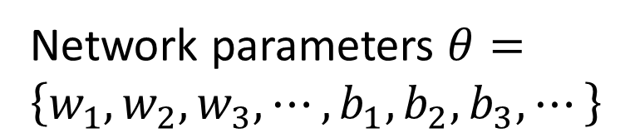
How to pick the best function
Find network parameters $θ^{∗}$ that minimize total loss L
Layer l
Layer l+1
Enumerate all possible values
Network parameters $θ=\left\{w_{1},w_{2},w_{3},⋯,b_{1},b_{2},b_{3},⋯\right\}$
10⁶
weights
……
……
Millions of parameters
E.g. speech recognition: 8 layers and 1000 neurons each layer
1000
neurons
1000
neurons
Notes:
百萬等級的
Solving this optimization problem by Calculus or something

Slide 33
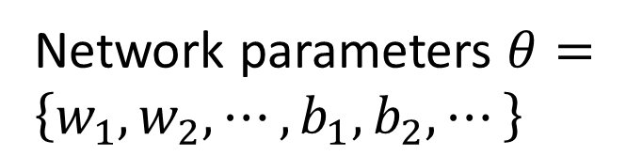
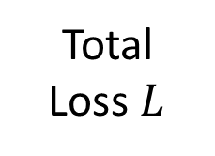
Gradient Descent
Network parameters $θ=\left\{w_{1},w_{2},⋯,b_{1},b_{2},⋯\right\}$
Find network parameters $θ^{∗}$ that minimize total loss L
Pick an initial value for w
Total
Loss $L$
Random, RBM pre-train
Usually good enough
Notes:
Consider a parameter w in $θ$

Slide 34
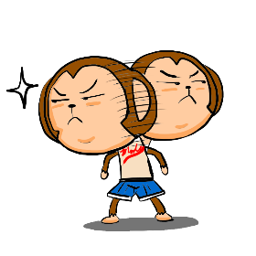
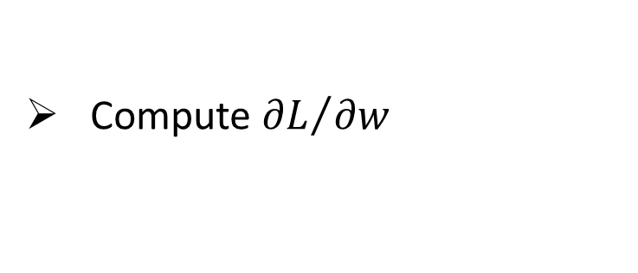
Gradient Descent
Network parameters $θ=\left\{w_{1},w_{2},⋯,b_{1},b_{2},⋯\right\}$
Find network parameters $θ^{∗}$ that minimize total loss L
Pick an initial value for w
Total
Loss $L$
Compute ${∂L}/{∂w}$
Negative
Increase w
Positive
Decrease w
http://chico386.pixnet.net/album/photo/171572850
Notes:
Consider a parameter w in $θ$
切線斜率

Slide 35
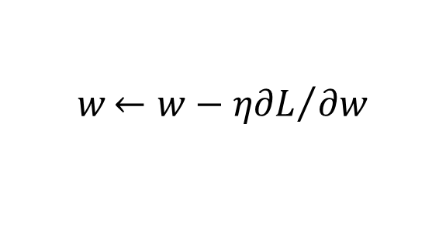
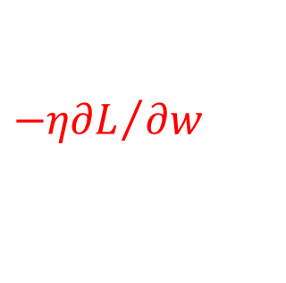
Gradient Descent
Network parameters $θ=\left\{w_{1},w_{2},⋯,b_{1},b_{2},⋯\right\}$
Find network parameters $θ^{∗}$ that minimize total loss L
Pick an initial value for w
Total
Loss $L$
Compute ${∂L}/{∂w}$
$$w{←w−η∂L}/{∂w}$$
Repeat
η is called “learning rate”
$${−η∂L}/{∂w}$$
Notes:
eta
Consider a parameter w in $θ$

Slide 36
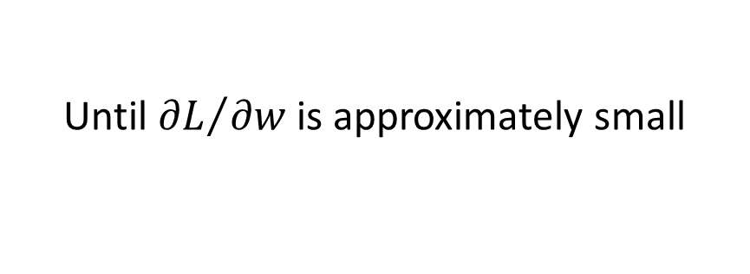
Gradient Descent
Network parameters $θ=\left\{w_{1},w_{2},⋯,b_{1},b_{2},⋯\right\}$
Find network parameters $θ^{∗}$ that minimize total loss L
Pick an initial value for w
Total
Loss $L$
Compute ${∂L}/{∂w}$
$$w{←w−η∂L}/{∂w}$$
Repeat
Until ${∂L}/{∂w}$ is approximately small
(when update is little)
Notes:
Consider a parameter w in $θ$

Slide 37
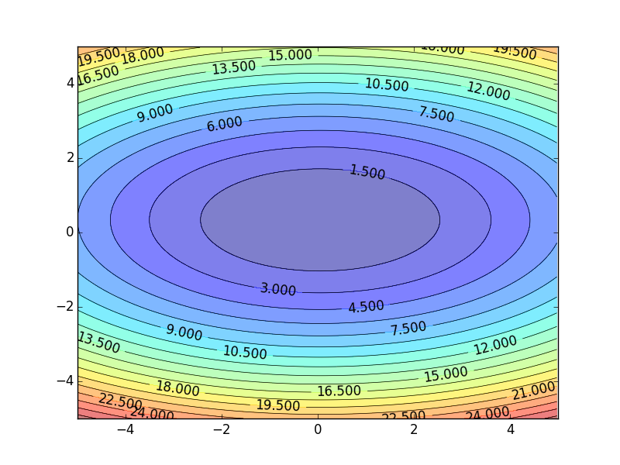
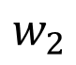
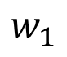
Gradient Descent
Color: Value of Total Loss L
$$w_{2}$$
Randomly pick a starting point
$$w_{1}$$
Notes:
A network can have millions of parameters.
Backpropagation is the way to compute the gradients efficiently (not today)
Ref: http://speech.ee.ntu.edu.tw/~tlkagk/courses/MLDS_2015_2/Lecture/DNN%20backprop.ecm.mp4/index.html

Slide 38
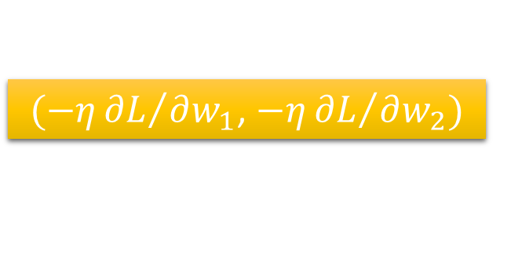
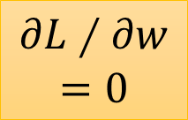
Gradient Descent
Hopfully, we would reach a minima …..
Color: Value of Total Loss L
$$w_{2}$$
$(−η{∂L}/{∂w_{1}}$, $−η{∂L}/{∂w_{2}})$
Compute ${∂L}/{∂w_{1}}$, ${∂L}/{∂w_{2}}$
$$w_{1}$$
Notes:
Questions: image you are playing AOC
A network can have millions of parameters.
Backpropagation is the way to compute the gradients efficiently (not today)
Ref: http://speech.ee.ntu.edu.tw/~tlkagk/courses/MLDS_2015_2/Lecture/DNN%20backprop.ecm.mp4/index.html

Slide 39
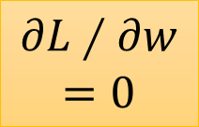

Local Minima
Total
Loss
Very slow at the plateau
Stuck at saddle point
Stuck at local minima
$$∂L∕∂w$$
$$≈0$$
$$∂L∕∂w$$
$$=0$$
$$∂L∕∂w$$
$$=0$$
The value of a network parameter w

Slide 40




Local Minima
Gradient descent never guarantee global minima
Different initial point
$$L$$
Reach different minima, so different results
$$w_{1}$$
$$w_{2}$$
Notes:
看人品的方法
Who is Afraid of Non-Convex Loss Functions?
http://videolectures.net/eml07_lecun_wia/

Slide 41


Gradient Descent
This is the “learning” of machines in deep learning ……
Even alpha go using this approach.
People image ……
Actually …..
I hope you are not too disappointed :p

Slide 42









Backpropagation
Backpropagation: an efficient way to compute ${∂L}/{∂w}$ in neural network
libdnn
台大周伯威
同學開發
Ref: https://www.youtube.com/watch?v=ibJpTrp5mcE
Notes:
amazon-dsstne

Slide 43
Three Steps for Deep Learning
Step 1: define a set of function
Step 2: goodness of function
Step 3: pick the best function
Deep Learning is so simple ……
Now If you want to find a function
If you have lots of function input/output (?) as training data
You can use deep learning

Slide 44


For example, you can do …….
Image Recognition
“monkey”
“monkey”
Network
“cat”
“cat”
“dog”
“dog”

Slide 45


For example, you can do …….
“Talk” in e-mail
Spam
filtering
Network
1/0
(Yes/No)
“free” in e-mail
1 (Yes)
0 (No)
(http://spam-filter-review.toptenreviews.com/)
Notes:
Can we have more examples ….

Slide 46


For example, you can do …….
政治
“stock” in document
Network
經濟
體育
“president” in document
體育
政治
財經
http://top-breaking-news.com/

Slide 47
Outline
“Hello World” for Deep Learning
Introduction of Deep Learning
Applications for Deep Learning
Notes:
The three steps can also apply on other machine learning methods

Slide 48

Keras
If you want to learn theano:
http://speech.ee.ntu.edu.tw/~tlkagk/courses/MLDS_2015_2/Lecture/Theano%20DNN.ecm.mp4/index.html
http://speech.ee.ntu.edu.tw/~tlkagk/courses/MLDS_2015_2/Lecture/RNN%20training%20(v6).ecm.mp4/index.html
Very flexible
or
Need some effort to learn
Easy to learn and use
Interface of TensorFlow or Theano
(still have some flexibility)
You can modify it if you can write TensorFlow or Theano
keras

Slide 49
Keras
François Chollet is the author of Keras.
He currently works for Google as a deep learning engineer and researcher.
Keras means horn in Greek
Documentation: http://keras.io/
Example: https://github.com/fchollet/keras/tree/master/examples
Notes:
角；觸角，觸鬚牛角
而謹慎的佩涅洛佩則説道：“尊敬的客人，夢幻是很難解釋清楚的，并不是所有的夢景都會變爲現實。來去無蹤的夢神一般穿行於兩座大門，一座由牛角制成，一座由象牙雕成。穿過象牙大門來到人的夢鄉的夢神，只會欺人，所現所説不會成爲現實。而通過牛角大門進入的夢神，卻給任何一個凡人帶真實可信的訊息。但是，我的夢境不是後一位夢神提供的，雖然那里情節讓我心情舒暢。

Slide 50

使用 Keras 心得

Slide 51

Example Application
Handwriting Digit Recognition
Machine
“1”
28 x 28
MNIST Data: http://yann.lecun.com/exdb/mnist/
“Hello world” for deep learning
Keras provides data sets loading function: http://keras.io/datasets/

Slide 52




Keras
28x28
……
500
……
500
……
Softmax
y₁
y₂
y₁₀
……

Slide 53


Keras

Slide 54

Keras
Step 3.1: Configuration
$$w{←w−η∂L}/{∂w}$$
0.1
Step 3.2: Find the optimal network parameters
Training data
(Images)
Labels
(digits)

Slide 55


Keras
Step 3.2: Find the optimal network parameters
numpy array
numpy array
28 x 28
=784
……
10
……
Number of training examples
Number of training examples
https://www.tensorflow.org/versions/r0.8/tutorials/mnist/beginners/index.html

Slide 56



Keras
Save and load models
http://keras.io/getting-started/faq/#how-can-i-save-a-keras-model
How to use the neural network (testing):
case 1:
case 2:

Slide 57
Keras
Using GPU to speed training
Way 1
THEANO_FLAGS=device=gpu0 python YourCode.py
Way 2 (in your code)
import os
os.environ["THEANO_FLAGS"] = "device=gpu0"
Notes:
THEANO_FLAGS=device=gpu0 python YourCode.py
import os
os.environ["THEANO_FLAGS"] = "device=cpu"

Slide 58
Outline
“Hello World” for Deep Learning
Introduction of Deep Learning
Applications for Deep Learning
Notes:
The three steps can also apply on other machine learning methods

Slide 59


Deep Style
Given a photo, make its style like famous paintings
https://dreamscopeapp.com/

Slide 60

Deep Style
Given a photo, make its style like famous paintings
https://dreamscopeapp.com/

Slide 61


Slide 62

More Application: Playing Go
Network
Next move
(19 x 19 positions)
19 x 19 matrix (image)
19 x 19 vector
19 x 19 vector
Fully-connected feedforward network can be used
Black: 1
white: -1
none: 0
But CNN performs much better.

Slide 63

Image Caption Generation
Input an image, but output a sequence of words
[Kelvin Xu, arXiv’15][Li Yao, ICCV’15]
A vector for whole image
a
woman
is
===
CNN
……
Input image
Caption Generation
Notes:
A woman is throwing a Frisbee in a part.

Slide 64






Video Caption Generation
A girl is running.
Video
A group of people is knocked by a tree.
A group of people is walking in the forest.

Slide 65

Chat-bot
電視影集 (~40,000 sentences)、美國總統大選辯論
Notes:
Will you build a wall?

Slide 66

Visual Question Answering
source: http://visualqa.org/
Notes:
太陽花梗

Slide 67


Creation
Draw something!
Notes:
就像教小朋友畫圖

Slide 68





PixelRNN
Ref: Aaron van den Oord, Nal Kalchbrenner, Koray Kavukcuoglu, Pixel Recurrent Neural Networks, arXiv preprint, 2016
Real
World

Slide 69


Generative Adversarial Network (GAN)
Ref: Generative Adversarial Networks, http://arxiv.org/abs/1406.2661
Notes:
https://www.quora.com/What-are-some-recent-and-potentially-upcoming-breakthroughs-in-unsupervised-learning
https://www.quora.com/

Slide 70






拟态的演化
http://peellden.pixnet.net/blog/post/40406899-2013-%E7%AC%AC%E5%9B%9B%E5%AD%A3%EF%BC%8C%E5%86%AC%E8%9D%B6%E5%AF%82%E5%AF%A5
棕色
叶脉
蝴蝶不是棕色
蝴蝶沒有叶脉
……..

Slide 71



The evolution of generation
NN
Generator
v1
NN
Generator
v2
NN
Generator
v3
Discri-minator
v1
Discri-minator
v2
Discri-minator
v3
Binary
Classifier
Real images:

Slide 72

Cifar-10
Which one is machine-generated?
Ref: https://openai.com/blog/generative-models/
Notes:
CIFAR-10 samples also look very sharp - Amazon Mechanical Turk workers can distinguish our samples from real data with an error rate of 21.3% (50% would be random guessing):
Amazon Mechanical Turk workers can distinguish our samples from real data with an error rate of 21.3% (50% would be random guessing):

Slide 73



Scenario of Reinforcement Learning
Observation
Action
Agent
Don’t do that
Reward
Environment

Slide 74


Scenario of Reinforcement Learning
Agent learns to take actions to maximize expected reward.
Observation
Action
Reward
Next Move
If win, reward = 1
If loss, reward = -1
Otherwise, reward = 0
Environment

Slide 75

Supervised v.s. Reinforcement
Supervised:
Reinforcement Learning
Next move:
“5-5”
Next move:
“3-3”
First move
…… many moves ……
Win!
Alpha Go is supervised learning + reinforcement learning.
Notes:
看著棋譜學

Slide 76
Thanks

